Slide 1

Bankruptcy and Personal Financial Records
Dollars and Sense

Slide 2

If your loans are continuously delinquent (overdue and not being paid), your lender will say that you have defaulted.
  Meaning you have not fulfilled the obligations of the loan.
  Sent to a collection agency & all the money is due at once. (This damages your credit history.)
If this is a continual problem with all of your bills, it may be a sign that you’ll have to file for bankruptcy.
How does bankruptcy work?
3
Notes:
Bankruptcy: A legal declaration of the inability to pay debt
Who should consider bankruptcy and what is involved?

Slide 3

What is bankruptcy?
BANKRUPTCY
Bankruptcy is the last resort when someone gets too deeply into debt. You realize you can’t pay your bills anymore because you don’t have enough money or resources to keep up with them.
This is an actual court legal procedure where you must file papers with the government.

Slide 4

When Should Bankruptcy be Considered?
Heavily in debt
Threats of foreclosure
Drop in income
Difficulty paying bills
Insufficient income
Loss of income due to a disability or divorce
4
Notes:
Bankruptcy is a legal declaration of the inability to pay one’s debts. There is a lot to consider, and one should not enter into bankruptcy without giving it careful thought. If the conditions listed on the slide describe you, then you might want to consider bankruptcy.
You are heavily in debt with little prospect of resolving it in the next five years
Creditors are threatening foreclosure on your home
You have experienced a drop in income
You pay bills late and have difficulty making the minimum payment on credit cards
You are paying more on monthly payments than you earn
You have recently become disabled or are going through a divorce resulting in the loss of income

Slide 5
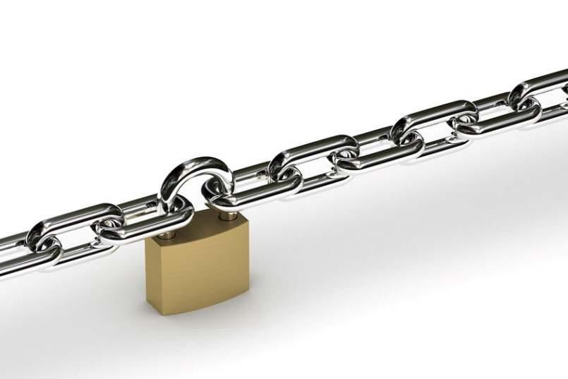
Disadvantages of Bankruptcy
Loss of privacy
Loss of assets (real estate, valuables)
Closed accounts
Forfeited luxury possessions (Car, boat, etc.)
Lien=claim on property to satisfy debt
A recent bankruptcy makes it nearly impossible to get a mortgage (buy a house)
5
Notes:
Disadvantages of bankruptcy:
You will lose all your credit cards (unless you pay them off before filing).
You may also have to forfeit some luxury possessions.
A recent bankruptcy makes it nearly impossible to get a mortgage (although you should be able to do so within about five years).
A bankruptcy stays on your credit report for 10 years, making it difficult to acquire credit, buy a home or car, get life insurance, or sometimes get a job.
Not all debts may be "discharged" in a bankruptcy. Student loans and back taxes (within 3 years) are prime examples.
Bankruptcy is an admission of defeat, an embarrassment.
Being sued for bad debts or having your car repossessed or your home foreclosed on is also an admission of defeat.
If you declare bankruptcy, your name will be in court records and may appear in the newspaper.
If your creditors sue you, your name will be in court records and may appear in the newspaper.
You will have to explain to a judge or trustee how you got into a financial mess.
Usually you can keep your home, but you might lose inheritance or insurance settlements if you own a business.

Slide 6
Advantages of Bankruptcy
Fresh financial start
You may be able to keep assets
Collection efforts stop
You can start rebuilding your credit and life sooner
6
Notes:
Advantages of bankruptcy:
When you file bankruptcy, it stops all collection actions by creditors, including foreclosures, repossessions and garnishments.
If you have filed with an attorney, he or she shields you by handling all inquiries from creditors.
Most states allow you to exempt your home, car and other essentials, so you will not wind up homeless and unable to get around.
Declaring bankruptcy now can get you started rebuilding your credit and life sooner. If there is another disaster, you may be able to amend your existing Chapter 13 plan to accommodate it.
While nothing will get rid of student loan debt, at least bankruptcy will prevent your lenders from aggressive collection action.
The biggest advantage is a fresh financial start.

Slide 7

Debts Usually Discharged
Credit card bills
Medical bills
Personal loans
Judgments resulting from car accidents
Payday loans
8
Notes:
List of debts usually discharged:
Typical bills such as credit card bills
Medical bills
Personal loans
Judgments resulting from car accidents as long as they do not involve alcohol or drugs
Payday loans

Slide 8

Debts typically not discharged
Student loans are almost always NOT discharged
Child support or alimony
Debts for breaking the law
Money from tax debts

Slide 9

Procedure for Filing
Complete forms and petition with a bankruptcy court
Before filing, the law requires that you receive financial education from a certified financial counselor
It also requires a Means Test
  Comparing your income to the average income in your state.
9
Notes:
To file bankruptcy, you must file a petition with a local bankruptcy court. After reviewing the petition, the court assigns a bankruptcy trustee to review your file. Your creditors cannot collect any debts owed them until the court contacts them. A federal code decides what assets are exempt and which ones are turned over to the court trustee to sell and apply toward your debts. You must go through credit counseling before your case is considered.

Slide 10
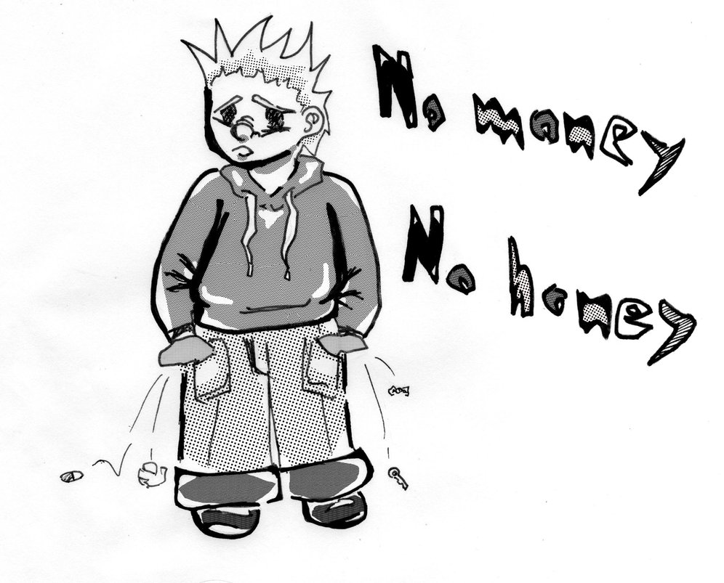
Bankruptcy Types
These are 2 most common types of bankruptcy:
Chapter 7
Chapter 13

Slide 11

Chapter 7
Bankruptcy removes your responsibility for paying most of your debts not secured by collateral.
    Collateral is property that guarantees a loan.
      Mortgage loans are guaranteed by real estate and car loans by the cars.
    You are allowed to keep exempt assets.
      This is the property you are allowed to keep when you file bankruptcy.

Slide 12

Chapter 13
Repayment bankruptcy is an option if you have income but can’t pay your debts.
    Allows you to pay your debts in installments over a three-to-five-year period.
    In general, you may keep all your property as long as you continue to make your Chapter 13 payments on time.
    Alimony and child support payments and long-term secured obligations such as your mortgage cannot be discharged.

Slide 13

    Bankruptcy remains on your credit report for up to 10 years
      This can make it difficult to get new credit, find a place to rent, get insurance or qualify for some jobs

Slide 14

How do I rebuild my credit?
You can being to rebuild your credit by getting a secured credit card.
A secured card requires a cash collateral deposit that becomes the credit line for that account. For example, if you put $500 in the account, you can charge up to $500

